Slide 1

Mind Bloom: A Mobile Mental Health App
Present By:
Ishmat Zahan
0242220005191001
Monisha Khan
0242220005191003
Efti sum ul Ahmed
0242220005191019
Supervisor Name: Fahad Mahmud

Slide 2

Purpose
Core Purpose
Provide accessible mental health support tailored to user needs
Break down barriers to mental health resources
Promote inclusivity in emotional well-being care
Key Features
Guided meditations for relaxation and focus
Mood tracking for self-awareness and progress monitoring
AI chatbot for interactive emotional support
User Empowerment
Encourages healthy habits and lifestyle changes
Community support through challenges and shared experiences
Fosters belonging, encouragement, and resilience
Overall Impact
Promotes self-awareness and emotional regulation
Empowers users to take charge of mental well-being
Leverages technology to enhance mental health care accessibility

Slide 3

01
Guided Meditations offer users a range of audio sessions tailored to their needs, promoting relaxation and mindfulness to combat stress and anxiety.
Key Features of Mind Bloom
Mood Tracking allows users to log their emotions daily, providing insights into their mental health trends and helping them understand triggers and patterns.
02
03
The AI Chatbot, known as EmoCare AI, delivers personalized support and resources, guiding users through coping strategies and providing immediate assistance when needed.

Slide 4
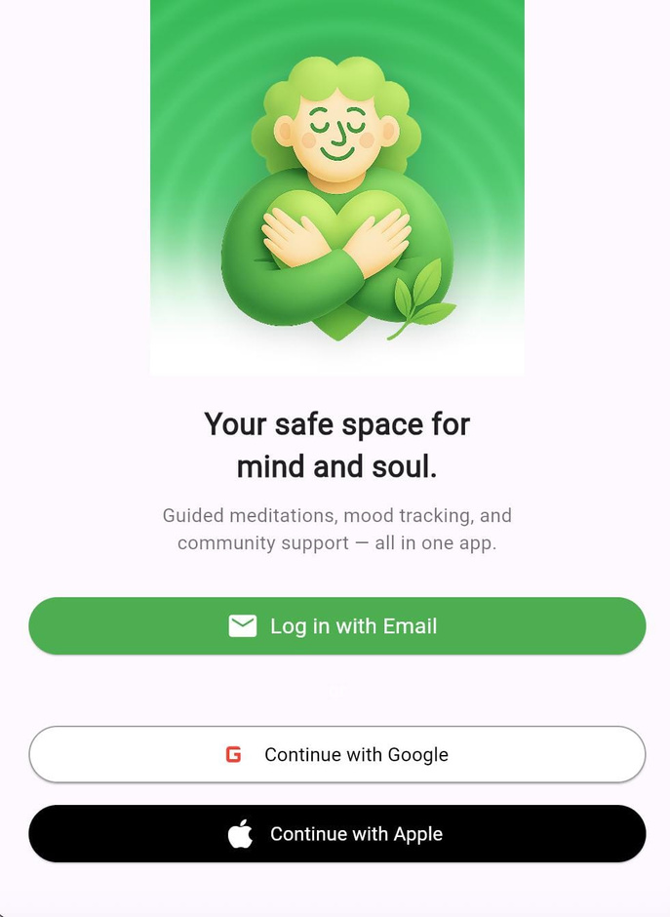
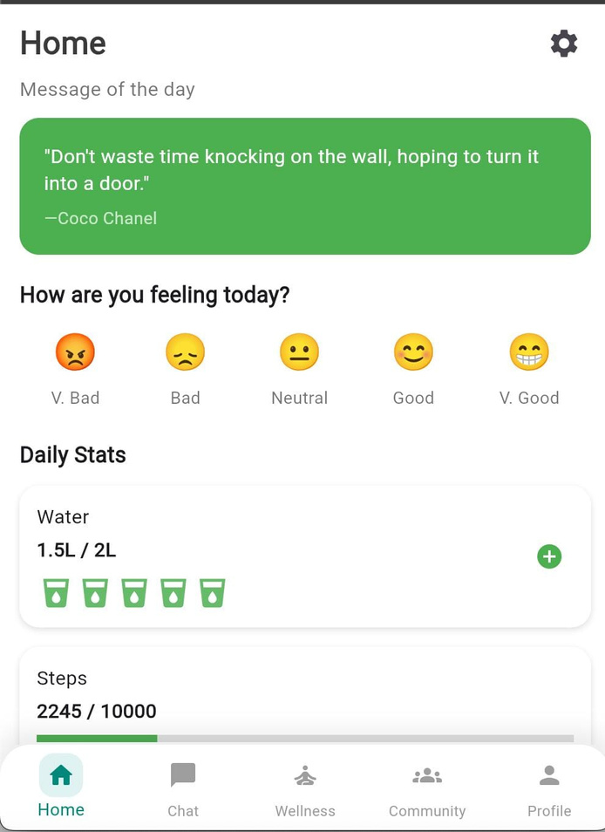
Login
Home
SECURE AND EASY ACCESS
CENTRAL HUB FOR USERS

Slide 5
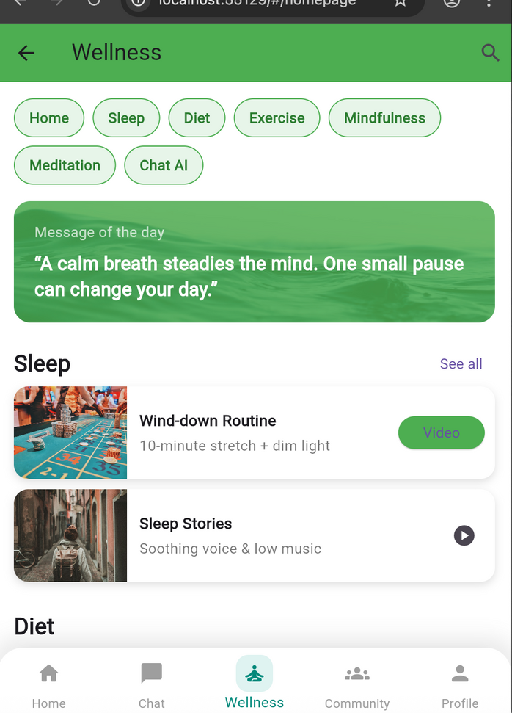
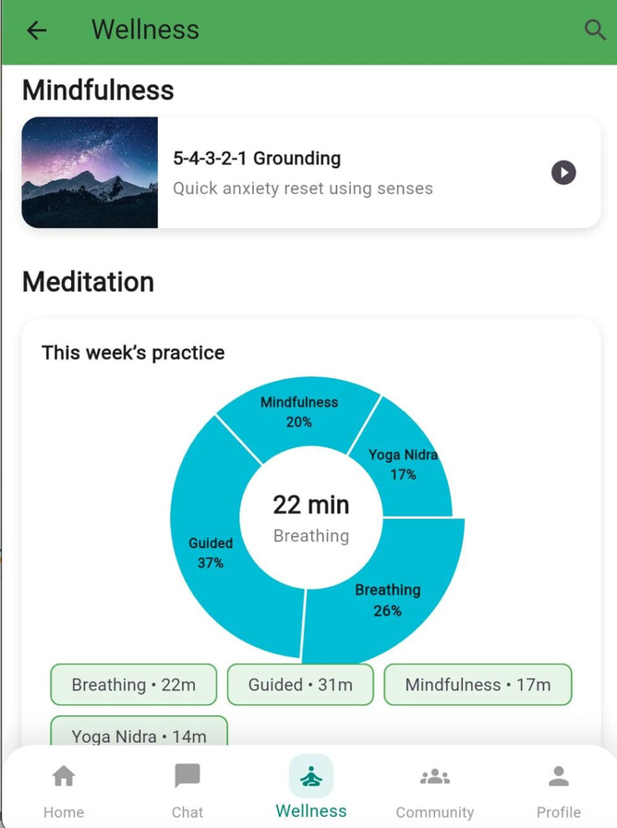
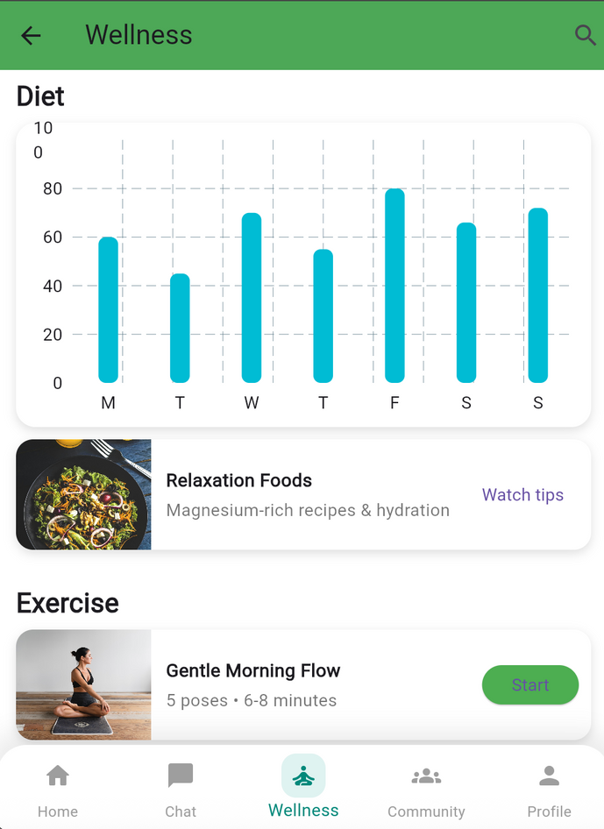
Meditation
GUIDED SESSIONS FOR RELAXATION

Slide 6
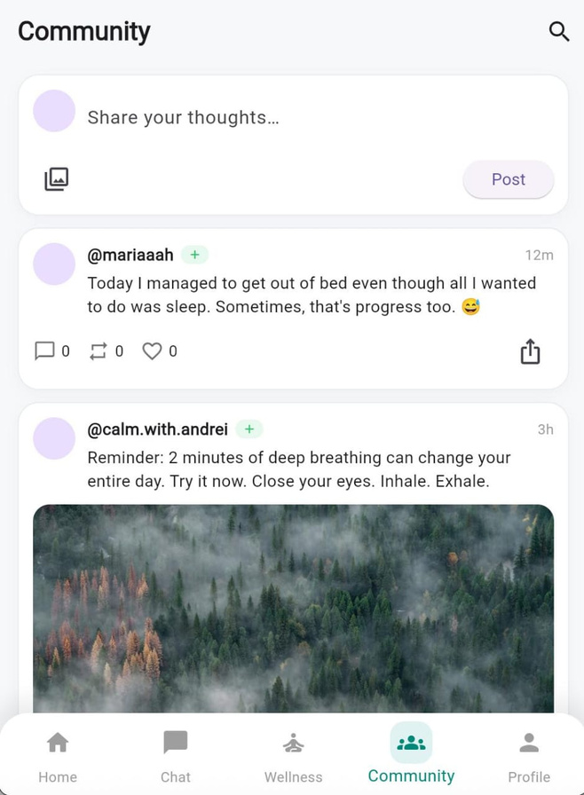
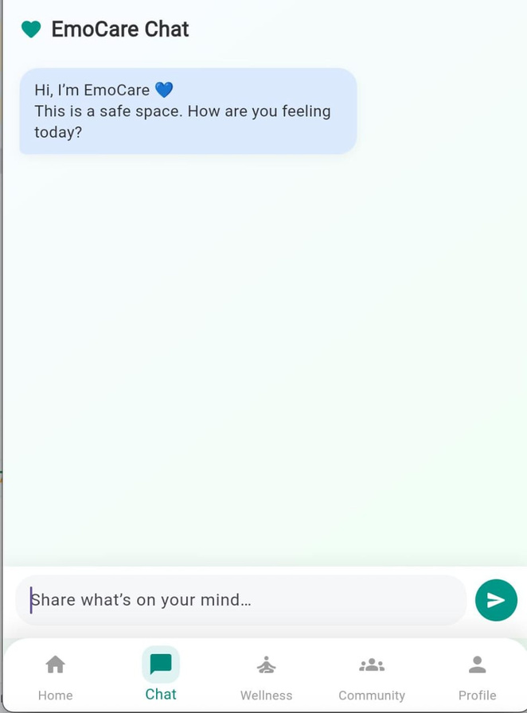
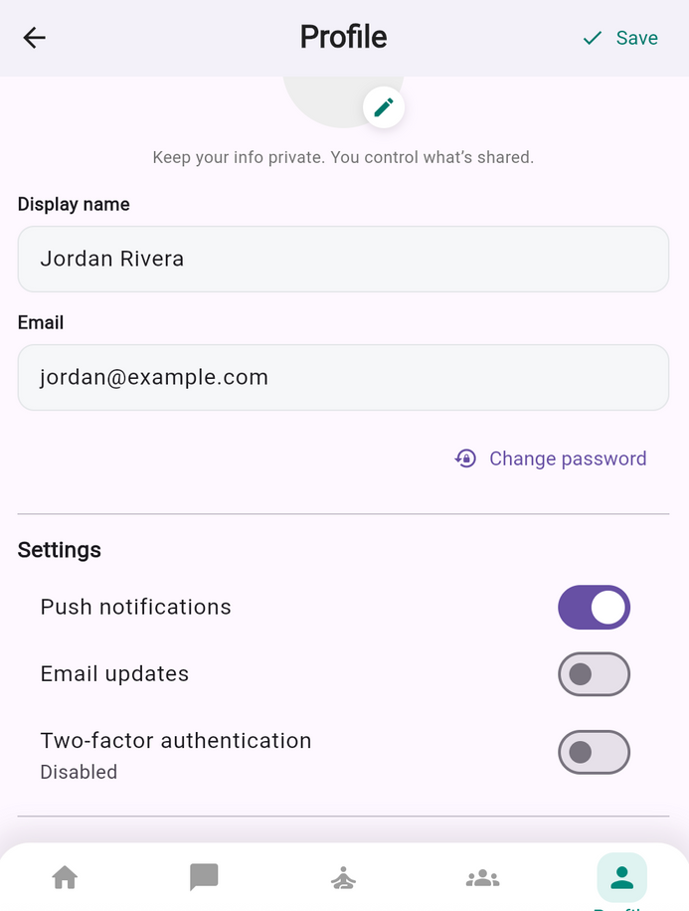
Community
Chatbot
Profile
CONNECT AND SHARE EXPERIENCES
EMOCARE AI FOR SUPPORT
USER INFORMATION

Slide 7
Backend & Database
Firebase Authentication
Secure login options: Email, Google, Apple
Maintains privacy and data integrity
Streamlined onboarding for seamless user experience
Safeguards sensitive user information
Firestore Database
Efficiently handles user data, mood logs, and community posts
Categorizes meditations and user interactions
Enhances engagement with personalized experiences
Cloud Storage
Stores large audio files and images securely
Ensures smooth access to media content
AI Integration (Dialogflow / OpenAI API)
Powers EmoCare AI chatbot
Provides personalized guidance and mental health support
Improves interactivity and user satisfaction

Slide 8
Implementation Workflow
Frontend Development
Built with Flutter for cross-platform compatibility
Intuitive, user-friendly interface with seamless navigation
Key features: Meditation, Mood Tracking, Community Support
Calming aesthetics aligned with the mental health theme
Focused on welcoming and supportive user experience
Firebase Backend
Authentication: Secure login via Email, Google, and Apple
Firestore Database: Organizes user data (MoodLogs, CommunityPosts)
Cloud Storage: Stores media files (e.g., meditation audio, images)
AI Integration: EmoCare AI chatbot for personalized support
Robust architecture ensures security and scalability

Slide 9
Testing Methods
Flutter Unit Testing
Ensures robustness of the application
Test cases verify individual component functionality
Quick identification and fixing of issues
Improves overall quality and reliability of the app
Firebase Emulator
Provides a safe testing environment for backend interactions
Prevents risks to real user data
Simulates various scenarios and user inputs
Ensures seamless communication between backend and frontend

Slide 10
Impact & Benefits
Impact on Society
Provides accessible mental health support
Helps combat stigma around mental health issues
Fosters connection through community features
Builds a supportive network for sharing experiences and resources
Impact on User Well-being
Encourages self-awareness through mood tracking
Promotes emotional regulation with guided meditations
Empowers users to improve their mental health
Fosters resilience and supports healthier daily habits

Slide 11
Future Scope
Voice AI Counseling
Provide accessible, interactive mental health support
Enhance user engagement with conversational assistance
Deliver personalized recommendations for emotional well-being
Offline Meditation Capabilities
Allow access to guided practices without internet
Ensure continuous support anytime, anywhere
Improve usability for users in low-connectivity areas
Integration with Wearable Devices
Track biometrics (stress levels, mood fluctuations, heart rate)
Tailor meditation and activity recommendations in real-time
Strengthen connection between physical and mental wellness
Overall Impact
More personalized, engaging, and resilient mental health experience
Expands accessibility and inclusivity of Mind Bloom
Positions the app as a comprehensive digital wellness platform

Slide 12
Thank You!
WE APPRECIATE YOUR ATTENTION AND SUPPORT
We are committed to improving mental health through innovative solutions, fostering a community where users can thrive emotionally and mentally.
Your feedback is invaluable to us as we continue to enhance the Mind Bloom app, ensuring it meets the needs of our users effectively.
Please feel free to reach out with any questions or suggestions. We look forward to connecting with you and discussing our project further.

